Slide 1

Wireless Monitoring System
Wearables
TEAM SOPAN
Aditya Kumar Jha (21BCE3759)
Yash Shekhawat (21BCE3123)

Slide 2
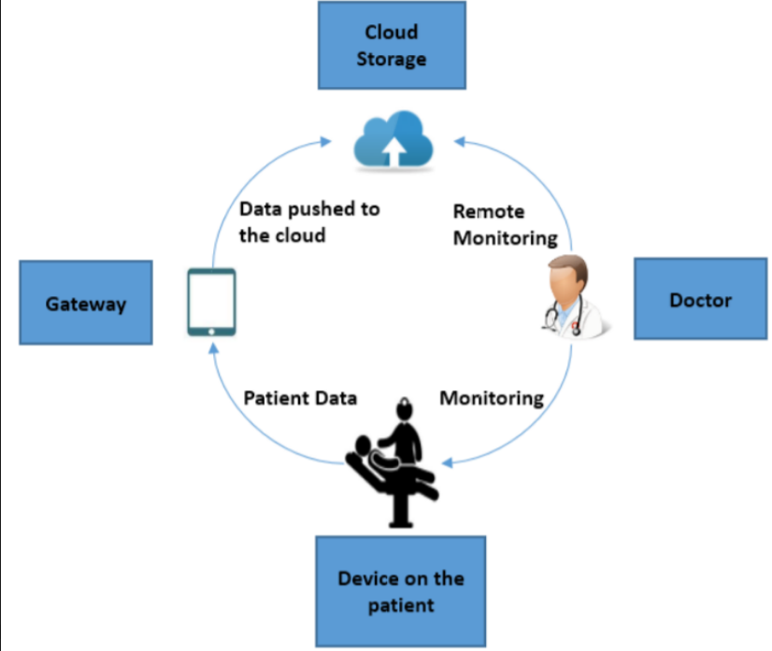

Slide 3
Remote ECG monitoring System
Features
Real Time Monitoring System from Ubidots Platform
Machine learning approach for Classification of heart beat and status trained using RNN for utmost accuracy.
Website for self evaluation of the Heart status of the patient
Stress level Evaluation from ECG data.

Slide 4
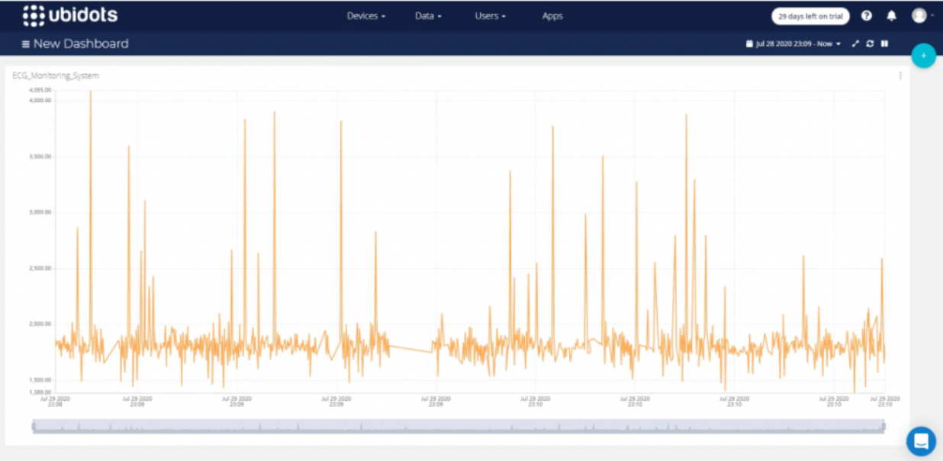
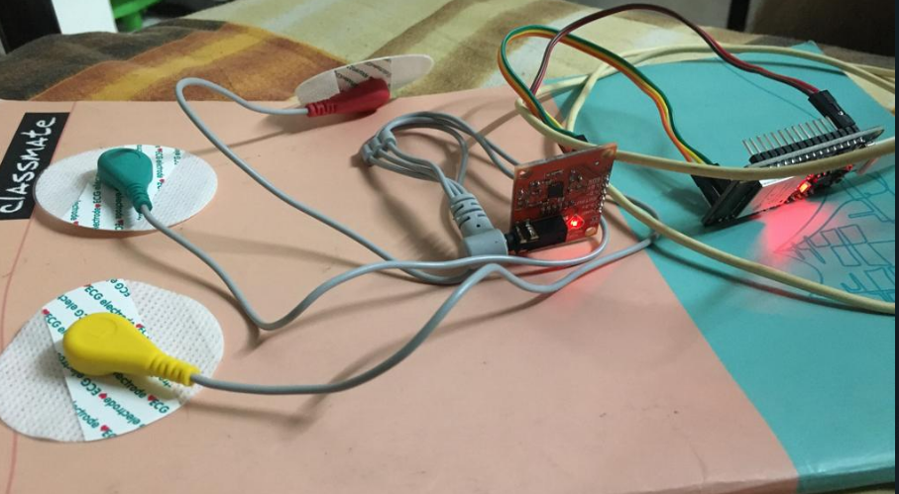
Ubidots platform and ESP32 with Heart monitor

Slide 5
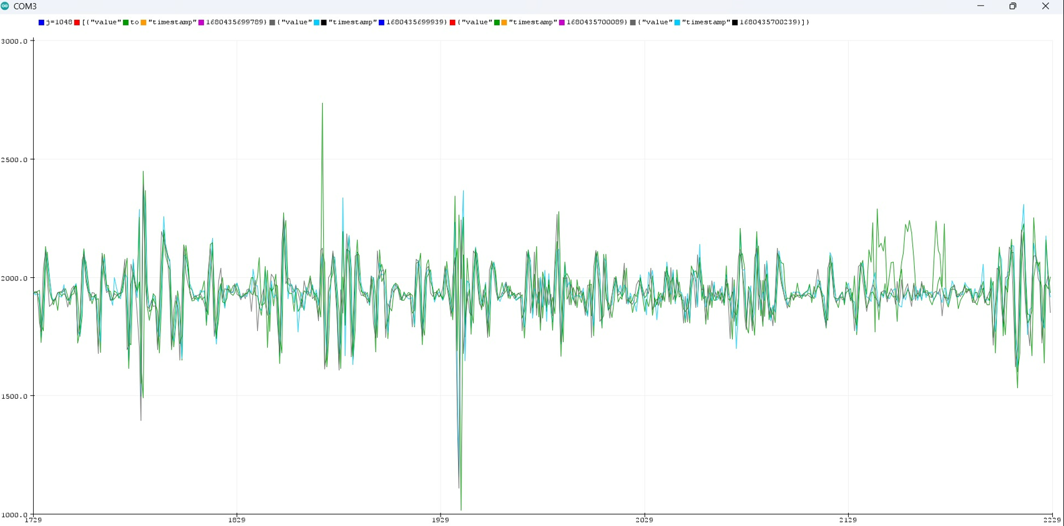
Aurdino code and ECG data from Plotter

Slide 6
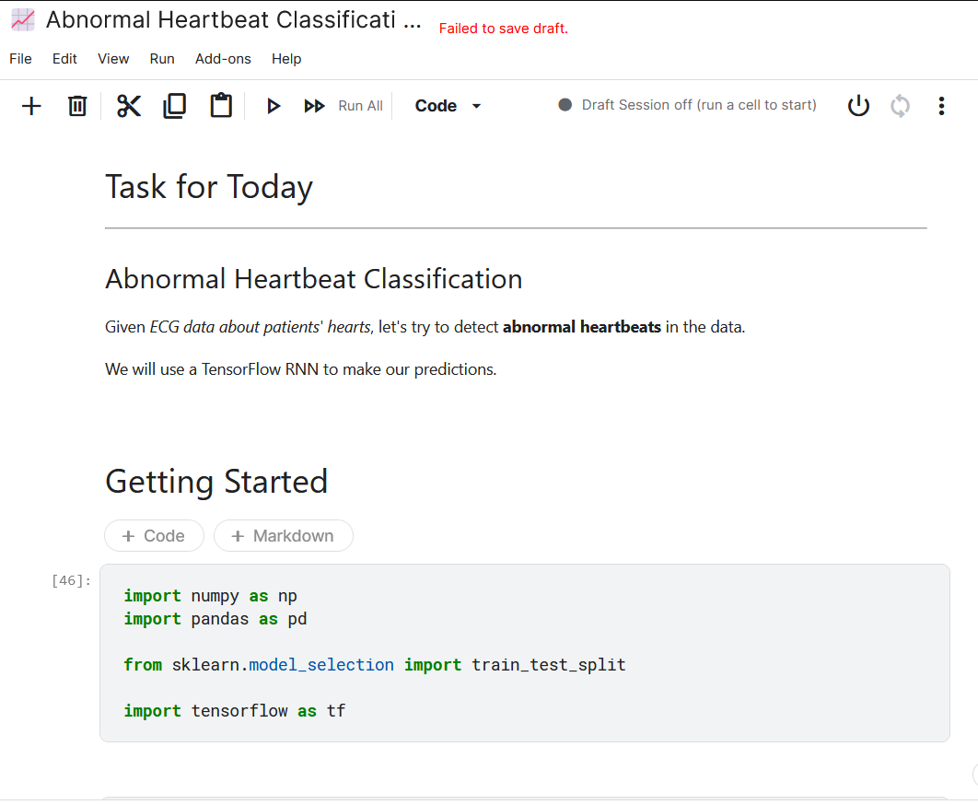
Trained model for Heart beat classification

Slide 7
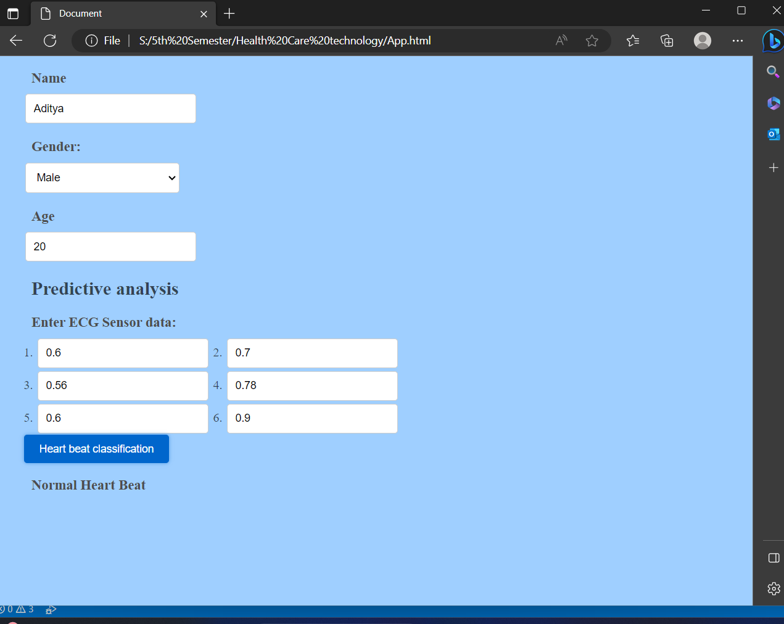
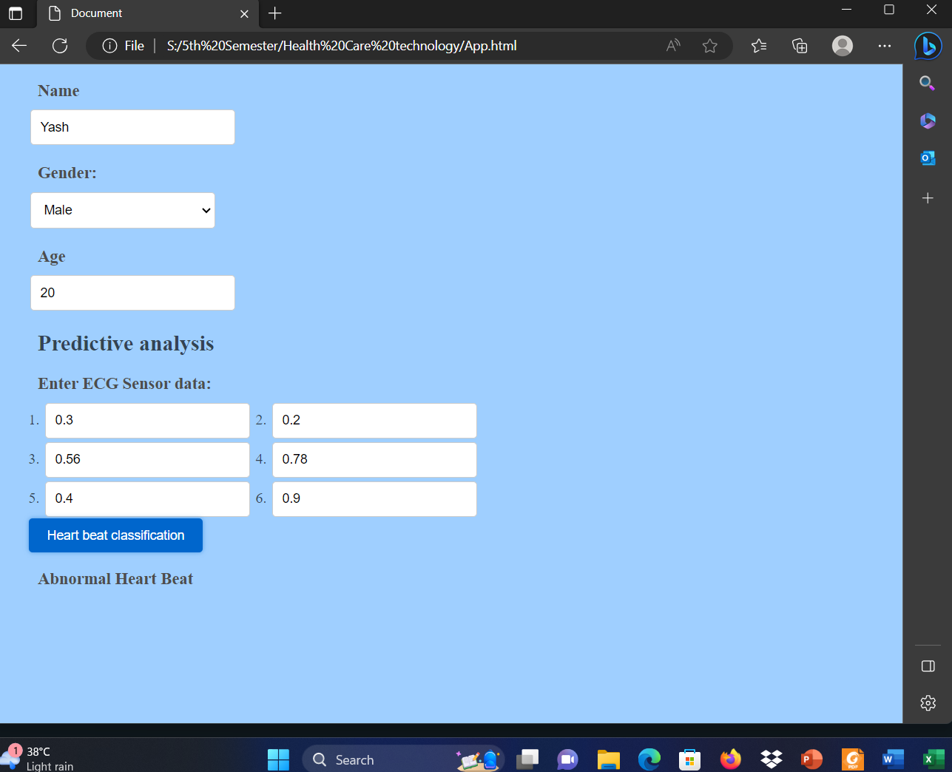
Result from the website

Slide 8
Stress Monitoring
Need
Stress when unmonitored can prove to be deleterious to a one’s health and can lead to chronic diseases.

Slide 9
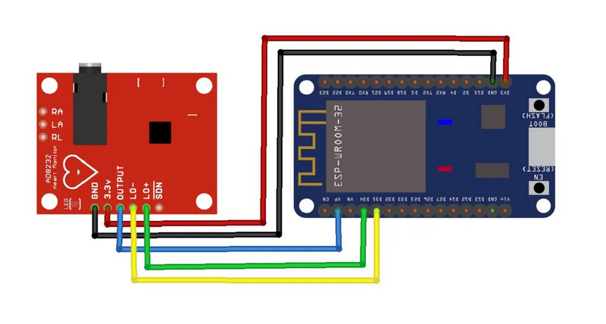

Slide 10
